Slide 1

DeepVision AI AI-Powered Fake Image Detection System
Under The Guidance Of
Prof. Saumil Trivedi
Developed By
Mayank Mali (2505112120085)
Zala Dhruvraj (2505112120009)
Pitroda Priyanshi (2505112120106)
Submitted To:
Department of MCA
Faculty of IT & Computer Science,
PARUL University

Slide 2











INDEX
DeepVision AI | MCA Department | PARUL University

Slide 3

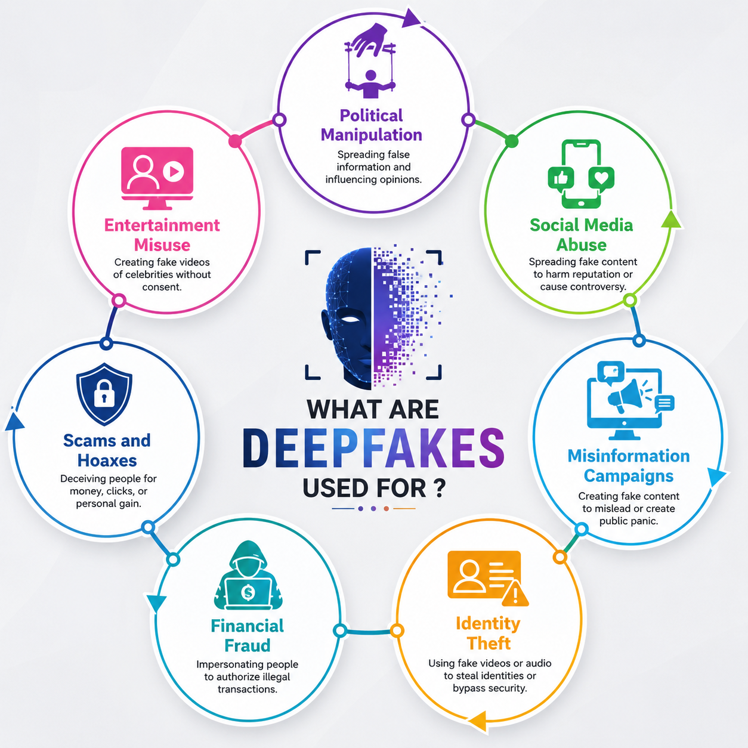
1. Introduction
What is DeepVision AI?
An advanced image authenticity detection system that differentiates between REAL photographs and AI-generated FAKE images using Deep Learning.
CNN-based binary classification (Real vs Fake).
High-accuracy probability analysis.
Real-time image processing and verification.
Modern responsive interface for instant results.
DeepVision AI | MCA Department | PARUL University

Slide 4












2. Application Areas
Cybersecurity
Social Media
News Verification
Prevents the spread of deepfakes and identity manipulation.
Verifying profile authenticity and reported content.
Combating misinformation and propaganda images.
Digital Forensics
Fake Profiles
Govt. Security
Analyzing evidence authenticity in legal investigations.
Detecting bot-generated profile pictures on networks.
Protecting official communications and credentials.
DeepVision AI | MCA Department | PARUL University

Slide 5
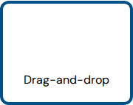
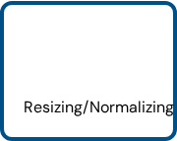
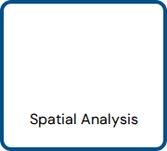
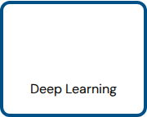
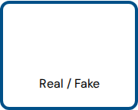

3. Methodology
01
02
03
04
05
Image Upload
Preprocessing
Feature Extraction
CNN Analysis
Prediction
The system utilizes a Sequential Convolutional Neural Network architecture trained on balanced datasets of real and diffusion-generated imagery to achieve peak classification accuracy.
DeepVision AI | MCA Department | PARUL University

Slide 6
4. Algorithms & Techniques
Convolutional Neural Network
ResNet-50 (Transfer Learning)
Vision Transformers (ViT)
GAN-Discriminator (Hybrid)
SVM (Frequency Baseline)
DeepVision AI | MCA Department | PARUL University

Slide 7
5. Tools & Technologies
Category | Technology Stack | Primary Function
Core Language | Python 3.11 | AI development and Backend processing.
AI / ML | TensorFlow & OpenCV | Model training and Image manipulation.
Backend | Flask | Lightweight REST API framework.
Frontend | React.js & Vite | Fast, modern and dynamic User Interface.
Styling | Tailwind CSS | Responsive utility-first design.
Deployment | GitHub & Vercel | Version control and continuous hosting.
DeepVision AI | MCA Department | PARUL University

Slide 8






6. Current / Latest R&D Works
Transformer-Based
Explainable AI
Universal Detection
Leveraging self-attention for global artifact detection.
Visualizing specific heatmaps of fake image pixels.
Detecting across all generators (DALL-E, Midjourney).
Frequency Domain
AI Watermarking
Semantic Fakes
Identifying unnatural signals in Fourier transforms.
Developing invisible markers for synthetic media.
Detecting logical inconsistencies in image context.
DeepVision AI | MCA Department | PARUL University

Slide 9
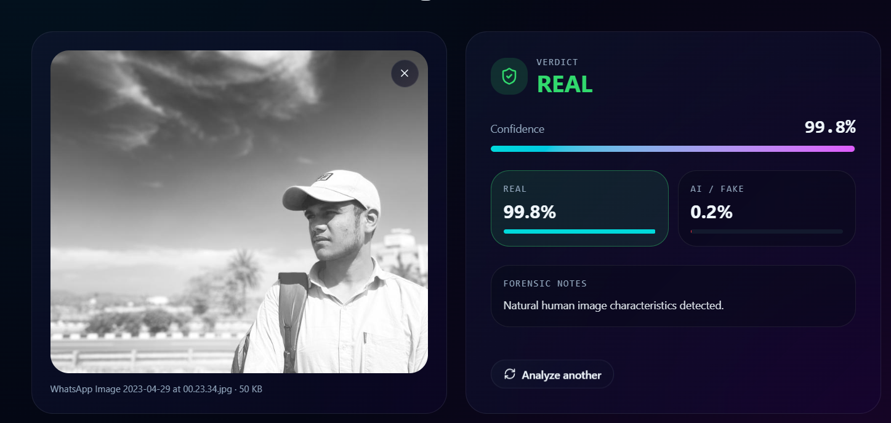
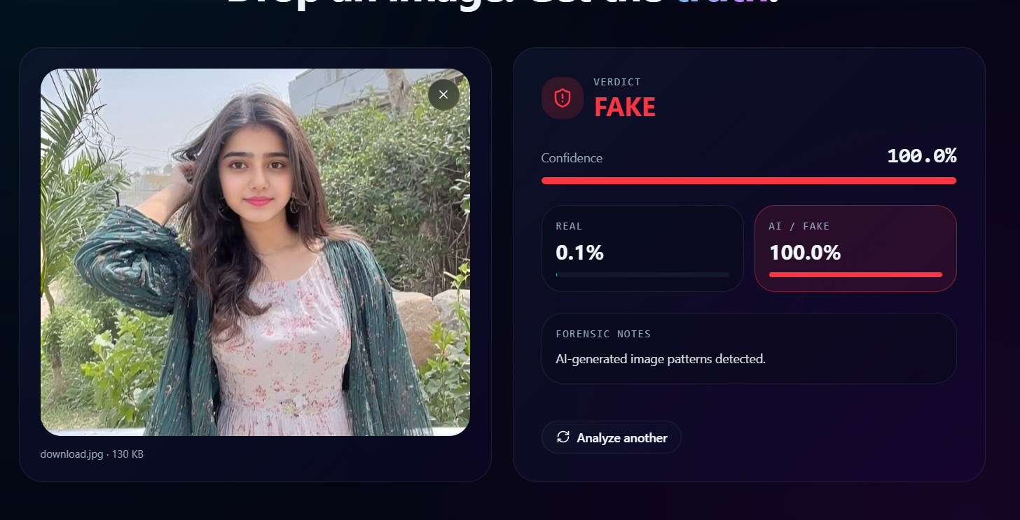


7. Results & Performance
REAL Prediction
FAKE Prediction
Confidence: 99.8%
Confidence: 100.0%
Output: Authentication Verified
Output: AI-Generated Content Detected
DeepVision AI | MCA Department | PARUL University

Slide 10

8. Future Scope
Video Deepfake Detection
Blockchain Result Verification
Live Camera Stream Analysis
Mobile App Implementation
AI Audio / Voice Verification
Multi-modal Detection (Text+Img)
Goal: A Unified Digital Truth Layer
To build an ecosystem where any digital asset—be it image, video, or audio—can be verified for authenticity instantly across any platform.
DeepVision AI | MCA Department | PARUL University

Slide 11

9. Conclusion
DeepVision AI successfully achieves 96%+ accuracy in detecting AI-generated images.
CNN architectures prove significantly effective in identifying synthetic spatial artifacts.
Real-time deployment via Flask and React provides a scalable solution for public use.
Future integrations will solidify the system as a primary defense against digital misinformation.
"Preserving the Integrity of Reality in an AI-Driven World."
DeepVision AI | MCA Department | PARUL University

Slide 12
10. Bibliography / References
[1] Goodfellow, I. et al. (2014). "Generative Adversarial Nets." Advances in Neural Information Processing Systems.
[2] Wang, S. et al. (2020). "CNN-generated images are surprisingly easy to spot... for now." IEEE Conference on Computer Vision and Pattern Recognition.
[3] Rombach, R. et al. (2022). "High-Resolution Image Synthesis with Latent Diffusion Models." CVPR.
[4] Corvi, R. et al. (2023). "Detection of Stable Diffusion Generated Images." IEEE ICASSP.
[5] Karras, T. et al. (2019). "A Style-Based Generator Architecture for GANs." IEEE Transactions on Pattern Analysis and Machine Intelligence.
[6] CIFAKE Dataset (2023). Kaggle: Real and AI-Generated Image Classification Dataset.
DeepVision AI | MCA Department | PARUL University

